Slide 1
Hoot: A Future Generation
CS 442
Chase Maier

Slide 2
What Do We Have Now?
HARDWARE
Small Form Computer
External Speaker
External Microphone
External Battery(s)
USB Flash Drive
SOFTWARE
Event Scheduling Interface
USB Transfer Script
Hoot Daemon

Slide 3
What Does This Allow Us To Do?
Play audio files at a designated time.
Record form environment at designated time.

Slide 4



What Are The Limitations?
You must choose a time of day to schedule an event. This is the only time this event will fire.
The battery life of the device is very limiting.
You need to physically visit the device to update schedules, retrieve recordings or interact with the system.

Slide 5

Any Other Concerns?
The use of different operating systems on the scheduling computer and on the box which is deployed in the wilderness prevents any possibility of building, updating, or maintaining a schedule on the deployed box while in the field, even if all of the necessary peripherals were available.

Slide 6

How Can We Improve?
Lets start by standardizing operating systems.
The scheduler and daemon should both be fully supported by Windows. This will provide the optimal support for peripheral driver support as well as provide an additional level of familiarity to the user of the system.

Slide 7
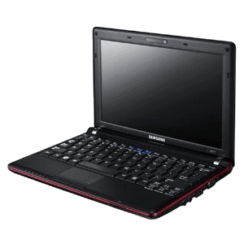
Lets Talk About Hardware!
A netbook is the perfect solution to our problem. Switching the daemon to run on a netbook would simultaneously solve almost all of the limitations that were discussed previously. Specifically, we can use Windows and the default battery life of these netbooks exceed 10 hrs.
Samsung N110-12PBK 10.1-Inch Black Netbook ---->

Slide 8
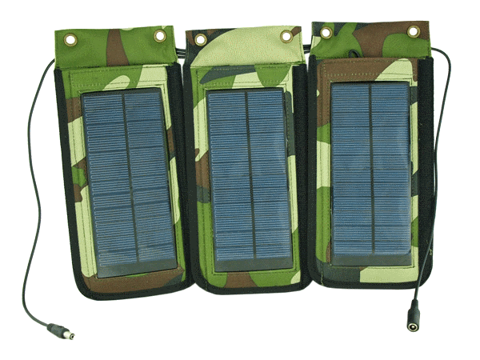
But We Want More…
If the increased batter life of 10+ hours is still insufficient, a solar charger can be used to trickle charge the low-powered netbook while in the field. This should provide the benefit of less frequent need to replace batteries on field devices.
<---- Portable Solar Power Charger
http://www.netbookcrunch.com/best-netbook-solar-chargers/

Slide 9
Okay, Lets Look At The Software!
Couldn’t we do more with the software than play and record audio at a given time of day?
What if we could setup a variety of triggers which could be used to initialize action sequences?

Slide 10
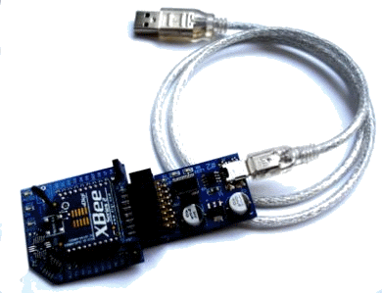
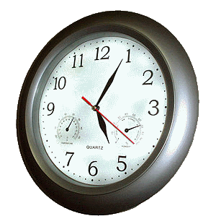
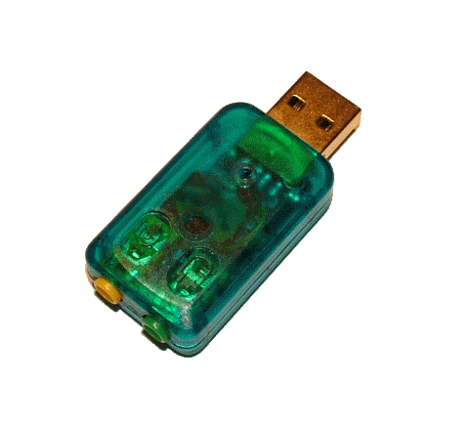
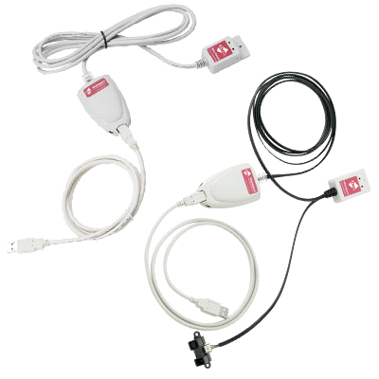
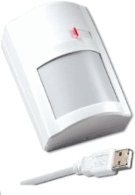
What Types Of Triggers?
Time Of Day – Based off of system clock.
Sensors
Movement
Temperature
Light
Audio (Mic w/ threshold)
Video
Combinations of requirements.

Slide 11
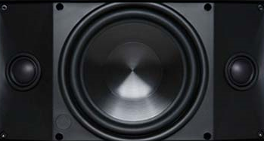
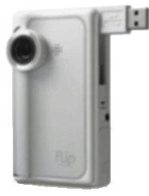
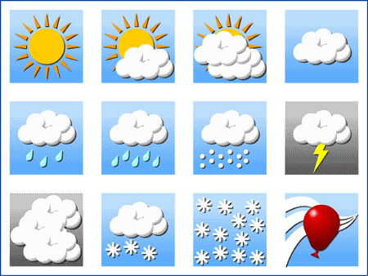
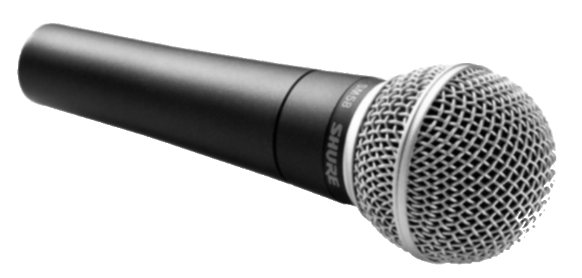
What Type Of Action Sequences?
A trigger could activate any combination of the below actions in a sequence.
Actions:
Play Audio
Record Audio
Record Video
Record Sensor Readings
Successive Actions or Simultaneous Actions

Slide 12

Some Other Improvements
In-Field Scheduling
The scheduler (action center) would support both importing a schedule created on another machine as well as on-the-fly creation of schedules using the I/O peripherals provided by the netbook.
Remote Accessible
The files and data recorded by the netbook should be available via a server. This data could be accessed via standard wireless networking (802.11x) as well as via the internet in regions where cell service is available by using mobile broadband wireless.

